Slide 1

CSmart
CS
Notes:
Hello everybody, today we would like to introduce you Csmart,

Slide 2
SMART CONSTRUCTION
CS
We believe in empowering the construction actors to get the most efficient solutions.
By using BIM technology, dynamo and generative design.
Developing an agnostic and intuitive tool to manage and control the location and time of the material arriving to the field.
Notes:
We believe in empowering the construction actors to get the most efficient solutions.
By using BIM technology, dynamo and generative design.
Developing an agnostic and intuitive tool to manage and control the location and time of the material arriving to the field.

Slide 3
CS
COST
ANALYSIS
Without CS
Headache
ORDER
EFFICIENCY
TIME
TIME IS
MONEY
With CS
TIME
JUST A SAMPLE…
PEOPLE WORKING | MINUTES SAVED X WORKER X DAY | MONTHS OF WORK | SAVED MINUTES | SAVED HOURS | PRICE PER HOUR | SAVED MONEY
20 | 20 | 6 | 48,000 | 800 | $12 | $9,600
WITHOUT TAKING INTO ACCOUNT…
BROKEN MATERIALS
COSTS OF REROUTINGS
COST TO CONTROL THE JOB
LATE MATERIALS IN FIELD
RELATIONSHIP WITH CLIENT
Notes:
With order you improve efficiency. An efficient project saves time. As we all know, time is money. And as we want to save you money and headaches, we developed Csmart.
Let’s take a look at a quick sample… If in a projects you have 20 people working, and with some provious field organization you could make your workers save at least 20 minutes per day, in a lapse of 6 months you would have saved 48thousand minutes of work. With an average hour rate cost of 12 dolars, just with a nice app you would have saved almost 10 thousand dolars. WITHOUT TAKING INTO ACCOUNT…
BROKEN MATERIALS
COSTS of REROUTINGS
COST TO CONTROL THE JOB
LATE MATERIALS IN FIELD
RELATIONSHIP WITH CLIENT

Slide 4
MAJOR IMPROVEMENTS
LOGISTICS
MAINTAIN ORDER
WASTE REDUCTION
CS
To keep a construction site productive good planning is key.
Logistical planning also means that materials are stored properly, easy to locate, and easy to move.
Planning in advance ensures that construction crews can work without interruption.
Notes:
There are three main improvement items with Csmart
LOGISTICS - MAIN ORDER AND WASTE REDUCTION
To keep a construction site productive good planning is key.
Logistical planning also means that materials are stored properly, easy to locate, and easy to move.
Planning in advance ensures that construction crews can work without interruption.

Slide 5
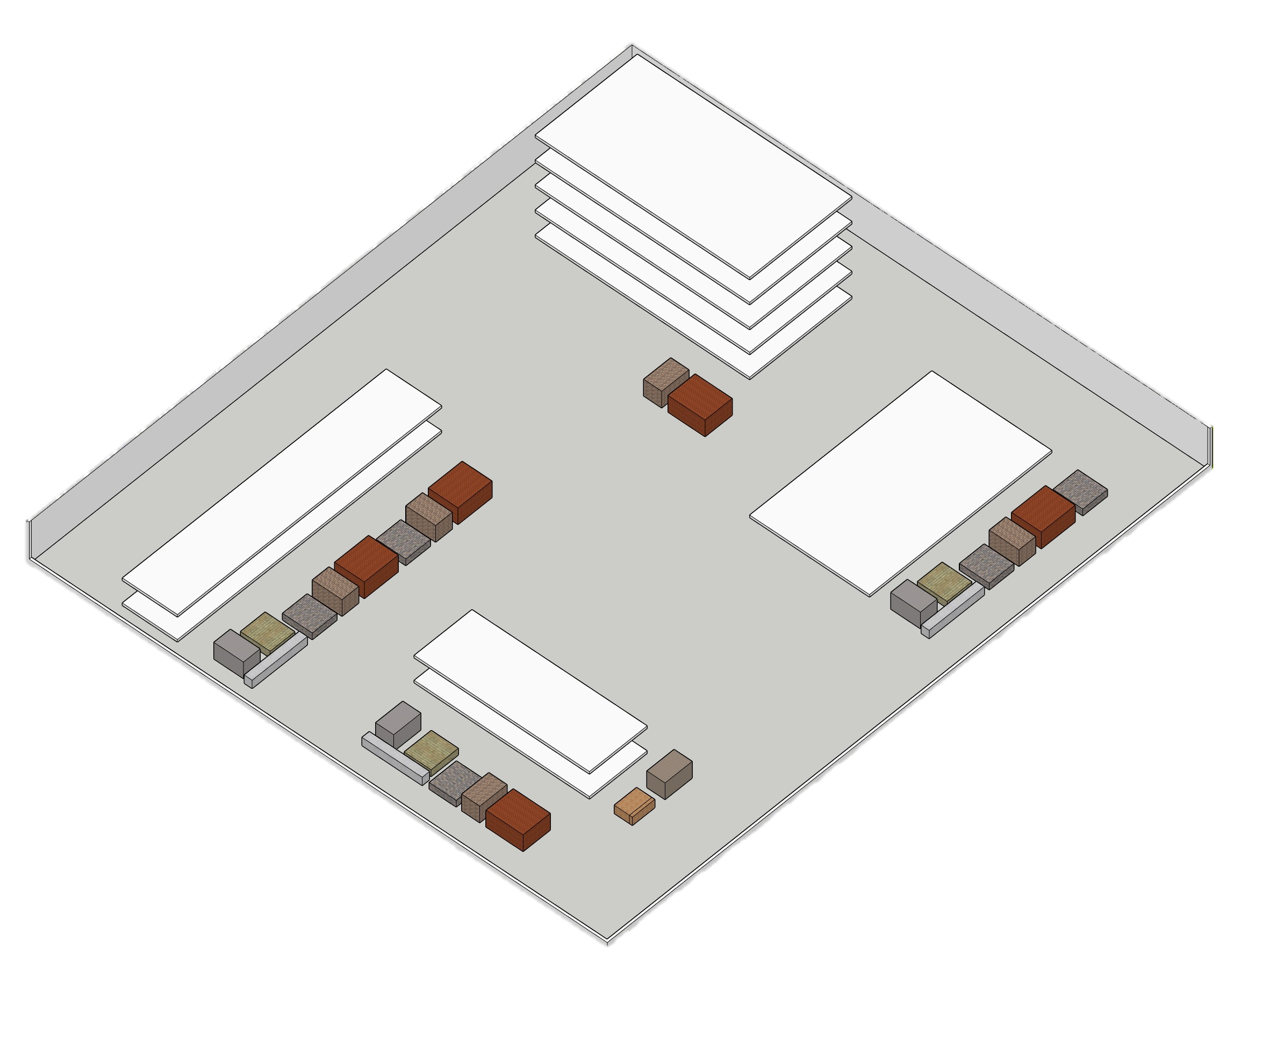
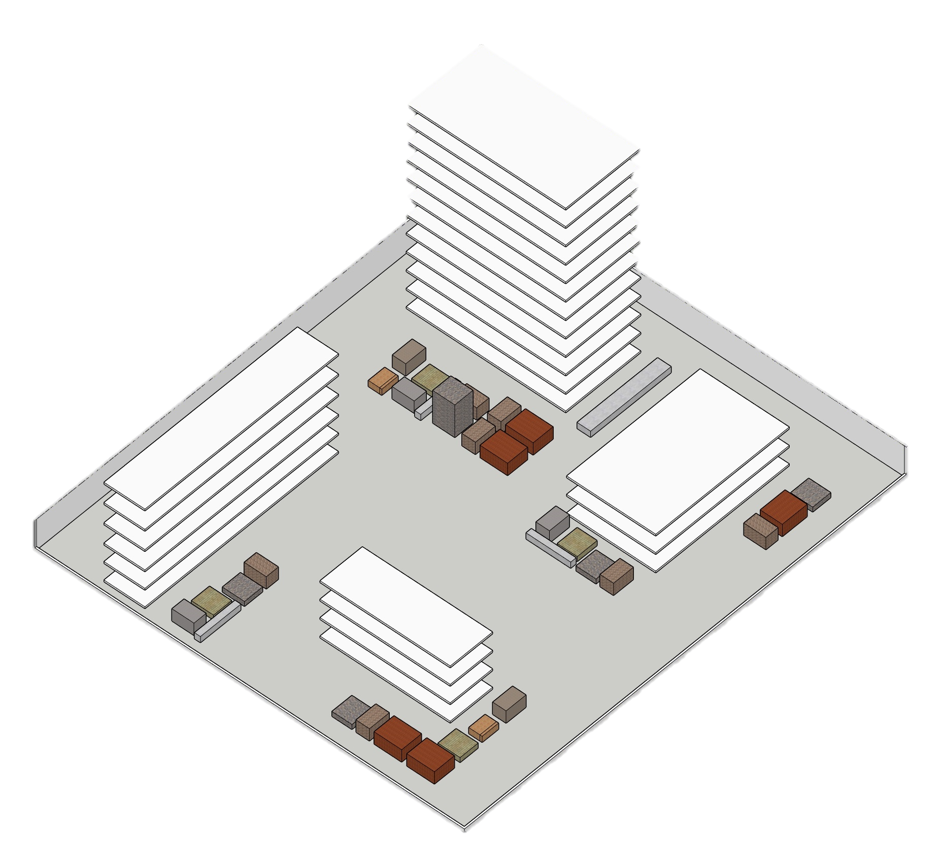
WORKFLOW
CS
SYNCHRO
FASE 1
REVIT
GANTT PROJECT
CS
SOLUTION
PROCORE
EXCEL
PRIMAVERA
OTHER
FASE 2
Notes:
The workflow would go like this. You bring any source of data from your model or project .. We are agnostic, right? … Then Csmart thinks for you. With generative design you can get the optimum location of materials in field, according to the phase or month when they should be installed.

Slide 6
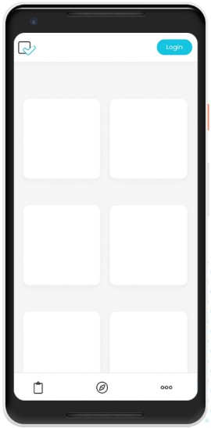
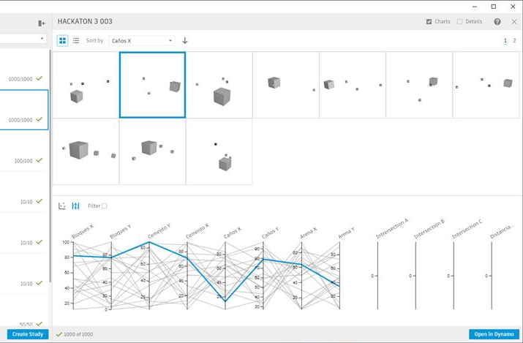
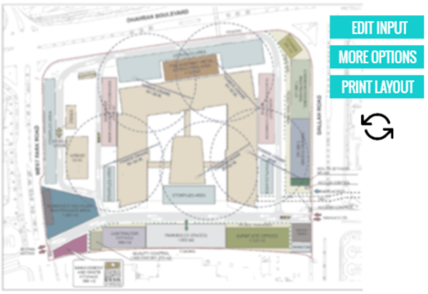
USER INTERFACE
CS
INCRESE PREDICTIBILITY
MITIGATE PROJECT RISKS
A NON STOP PROCESS TO THE WAY WE DO BUSINESS
EASY TO MANIPULATE
AND ACCESIBLE
How does it work?
What will you get?
DYNAMO AND REFINERY GENERATIVE DESIGN
PROJECT REPORT
YOUR CS PROJECT
SITE
AREA
BUILDING
AREA
MATERIALS
PRICES
SUPPLIERS
SCHEDULE
Notes:
The user interfase has 3 big aims:
TO BE EASY TO MANIPULATE AND ACCESIBLE
TO INCRESE PREDICTIBILITY AND MITIGATE PROJECT RISKS
WITH A NON STOP PROCESS TO THE WAY WE DO BUSINESS
How does it work? In the backend dynamo and refinery with generative design start searching for the best way to accommodate materials in field according to your inputs and project scenarios.
What will you get? A nice project report that you could manage from a device that includes a layout with the best organization of your stock and packages in field.

Slide 7
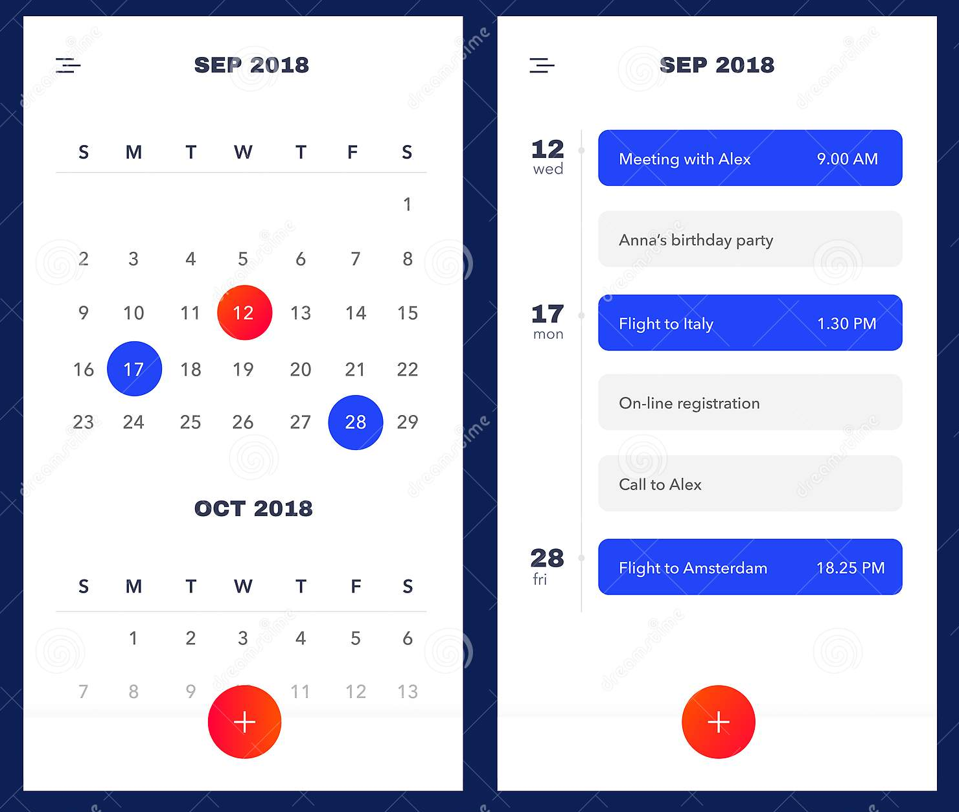





A SPOILER TO THE FUTURE
CS
LOGISTICS
Piping Arrives
Meeting with Anne
Bricks Arrives
Call with John
Tylor’s birthday
Order Sand Truck
Notes:
We believe that field experience would be better if you let Csmart warn you about issues before they screw your project. Some day probably it could be part of your calendar, and a daily tool for your coworkers.

Slide 8


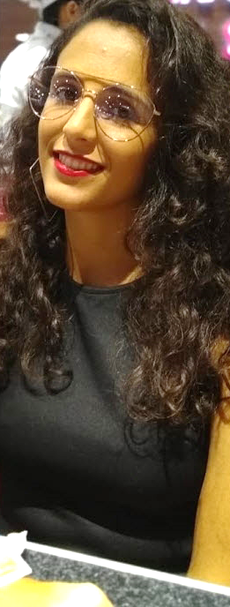

THE TEAM
Muriel Aguilar
María Daniela Cuadrado
Franca Lucía Cattaneo
CS
Juan Cruz Mendez Casariego
Architect, the dynamo guy.
BIM Modeler at ENGworks. Argentina.
Civil Engineer, the operations girl.
Job Captain at ENGworks. Argentina.
Civil Engineer, the piping girl.
BIM Modeler at ENGworks. Argentina.
Architect, the BIM and design addict.
Job Captain at ENGworks. Argentina.
Notes:
Thank you for your time, we are Juan Cruz mendez casariego, Muriel Aguilar, maria Daniela cuadrado and me, franca Cattaneo.

Slide 9
CS
Getting the right materials, to the right place, at the right time.
Notes:
CSMART
Getting the right materials, to the right place, at the right time.

